Slide 1
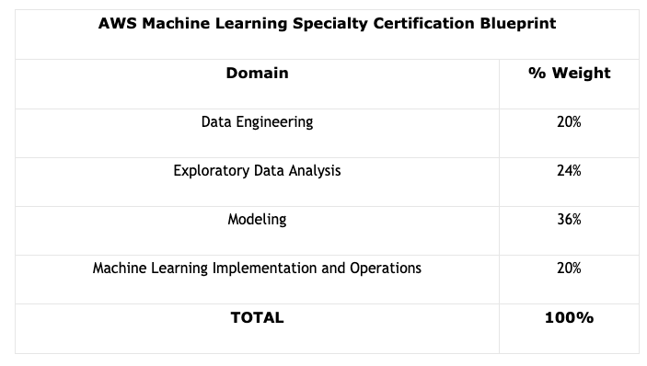

AWS Machine Learning Specialty Certification Exam
Course Outline

Slide 2
AWS Machine Learning Foundational Concepts
Terminology
Model
Random Cut Forest
Algorithm
GPU
One-Hot-Encoding
Inference
Blazing Text
Data Streams
Confusion Matrix
Transformer
XGBoost

